Slide 1
RENEWABLE ENERGY
Name Of The Student | Roll No
1) HASAN ALI AL IDROOS | 160317733023
2) MOHD. FAZALUDDIN | 160317733027
3) HAMED MOHIUDDIN REHAN | 160317733043
4) SULTAN MOHIUDDIN | 160317733049
GUIDE NAME:- SARA TABASSUM
ASST. PROFESSOR

Slide 2
Introduction
Renewable energy is energy produced from sources that do not deplete or can be replenished within a human’s life time. The most common examples include solar, hydro, wind energy etc.
Renewable energy accounts for 13.5% of the world’s total energy supply, and 22% of the world's electricity. Renewable energy systems are a major topic when discussing the globe's energy future for two main reasons:
Renewable energy systems provide energy from sources that will never deplete.
Renewable energy systems produce less greenhouse gas emissions than fossil fuels energy systems.
Most renewable energy comes either directly or indirectly from the sun. Sunlight, or Solar energy can be used directly for heating and lighting homes and other buildings, for generating electricity, and for hot water heating, solar cooling, and a variety of commercial and industrial uses. The sun's heat also drives the winds whose energy is captured with wind turbines. Then, the winds and the sun's heat cause water to evaporate. When this water vapour turns into rain or snow and flows downhill into rivers or streams, its energy can be captured using Hydroelectric power.

Slide 3
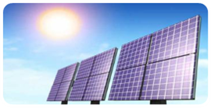
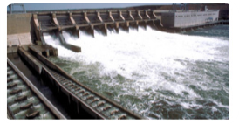
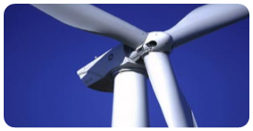
Types of Renewable Energy
Solar Power
  Photovoltaic
  Solar-thermal
Hydro Power
Wind Power

Slide 4
1)Solar Energy
Solar energy is radiant light and heat from the Sun that is harnessed using a range of ever-evolving technologies.
Such as solar heating, photovoltaics, solar thermal energy, solar architecture, molten salt power plants and artificial photosynthesis.
Here are three ways solar panels benefit the environment:-

Slide 5
Solar energy is radiant light and heat from sun that is harnessed using photovoltaics, solar heaters etc.
Here are three ways solar panels benefit the environment.
Solar energy reduces water pollution. Solar energy reduces air pollution.mSolar energy reduces hazardous waste.72 percent of water pollution comes from coal-fired power plants.
Generating energy from solar panels instead of fossil fuels can improve public health and river ecosystem.
31 percent of greenhouse gas emissions in US comes from electricity production. Solar energy systems can mitigate some of the damage as solar panels don't produce any greenhouse gases.
More than 400 million tons of hazardous waste is produced every year, according to United Nations Environmental Program. Nuclear fission products, in particular, continue to be radioactive for thousands of years.

Slide 6
Advantages
Solar power is pollution free and causes no greenhouse gases to be emitted after installation.
Reduced dependence on foreign oil and fossil fuels.
Virtually no maintenance as solar panels last over 30 years.
Solar can be used to heat water, power homes and building, even power cars.

Slide 7
Disadvantages
High initial costs for material and installation.
Needs lots of space as efficiency is not 100% yet.
No solar power at night so there is a need for a large battery bank.
Cloudy days do not produce much energy.

Slide 8
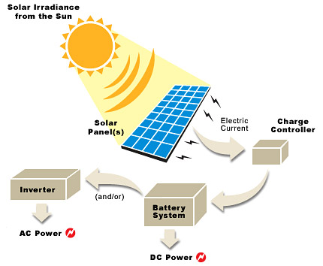
Solar Power- Photovoltaic
Current is generated through Photovoltaic effect -flow of free electrons in Silicon Panel due to solar irradiance
Direct current (DC) is generated which can be stored in a battery or converted to Alternating Current (AC)

Slide 9
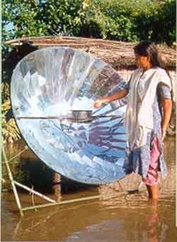
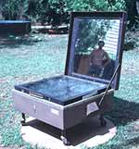
EXAMPLE OF SOLAR ENERGY
SOLAR COOKER

Slide 10
2) Hydro Power
Water energy is one of the five renewable green energy sources. The other four sources being: Wind, Solar, Biomass and Geothermal.
Water energy or hydro-energy is divided in 3 main categories: the hydroelectric energy, tidal energy and wave energy with the last two being categorized under the category of Ocean energy.
Water energy is divided in 3 main categories.
They are as follows:-
2.(i) Tidal Energy
2.(ii) Hydro-Electric Energy
2.(iii) Wave Energy

Slide 11
Categories of Hydro-Power
Tidal Energy
Tidal energy is a form of water energy, hydro-energy, which falls in the category of ocean energy.
As the name implies it is a form of energy that converts the energy of tides into useful electric energy.
Hydro-electric Energy
This is the most common and the most widely used form of renewable green energy sources.
Hydroelectric energy has a lower cost than any other form of renewable sources and in some cases over conventional forms of energy and this gives a clear benefit to the consumer since it is free of C02 emissions.
Wave Energy
Wave energy is the energy captured from the energy of ocean surface waves and that it is used to do useful work.
Wave energy can be used not only of the production of electricity, which is its most common use, but for water pumping and water desalination as well.

Slide 12
Advantages
Hydropower is a fueled by water, so it's a clean fuel source.
Hydropower doesn't pollute the air like power plants that burn fossil fuels, such as coal or natural gas.
Hydropower is a domestic source of energy, produced in the United States.
Hydropower relies on the water cycle, which is driven by the sun, thus it's a renewable power source.
Hydropower is generally available as needed; engineers can control the flow of water through the turbines to produce electricity on demand.

Slide 13
Disadvantages
Hydropower can impact water quality and flow. Hydropower plants can cause low dissolved oxygen levels in the water, a problem that is harmful to riparian(riverbank) habitats.
Is addressed using various aeration techniques, which oxygenate the water. Maintaining minimum flows of water downstream of a hydropower installation is also critical for the survival of riparian (riverbank)habitats.
Hydropower plants can be impacted by drought. When water is not available, the hydropower plants can't produce electricity.New hydropower facilities impact the local environment and may compete with other uses for the land
Those alternative uses may be more highly valued than electricity generation. Humans, flora, and fauna may lose their natural habitat.

Slide 14
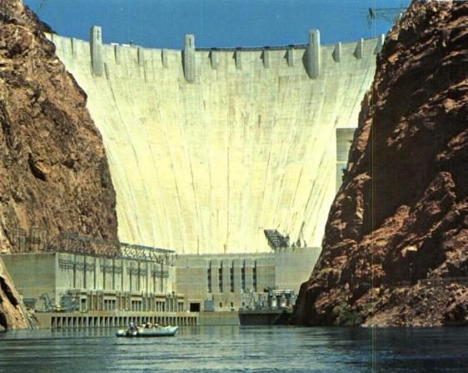
Examples of Hydro Power
Hoover Dam

Slide 15
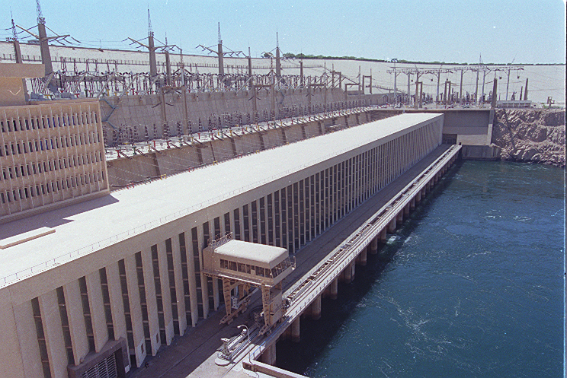
Aswan High Dam

Slide 16
3) Wind Energy
Wind power converts the kinetic energy in wind to generate electricity or mechanical power. This is done by using a large wind turbine usually consisting of propellers; the turbine can be connected to a generator to generate electricity, or the wind used as mechanical power
Wind is converted by the blades of wind turbines
To create electricity from wind the shaft of the turbine must be connected to a generator. The generator uses the turning motion of the shaft to rotate a rotor which has oppositely charge magnets and is surrounded by copper wire loops. Electromagnetic induction is created by the rotor spinning around the inside of the core, generating electricity

Slide 17
Advantages of Wind Energy
Industrial and Domestic Installation:– Wind turbines can be built on existing farms or ranches where most of the best wind sites are found.
Clean & Environment friendly Fuel source:– It doesn’t pollute air like power plant relying on combustion of fossil fuel.
Renewable & Sustainable:– Winds are caused by heating of atmosphere by the sun, earth surface irregularities and the rotation of the earth.
Job Creation:– Jobs have been created for the manufacture of wind turbines, the installation and maintenance of wind turbines and also in wind energy consulting

Slide 18
Disadvantages
Fluctuation of Wind and Good wind sites:– Wind energy has a drawback that it is not a constant energy source. Although wind energy is sustainable and will never run out, the wind isn’t always blowing.
Noise and aesthetic pollution:– Wind turbines generate noise and visual pollution. A single wind turbine can be heard from hundreds of meters away. Although steps are often taken to site wind turbines away from dwellings.
Not a profitable use of land:– Alternative uses for the land might be more highly valued than electricity generation.
Threat to wildlife:– Birds have been killed by flying into spinning turbine blades.

Slide 19
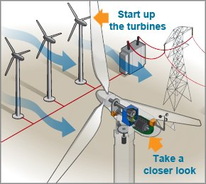
Examples
3.(i)Generation of Electricity from Wind Turbines

Slide 20
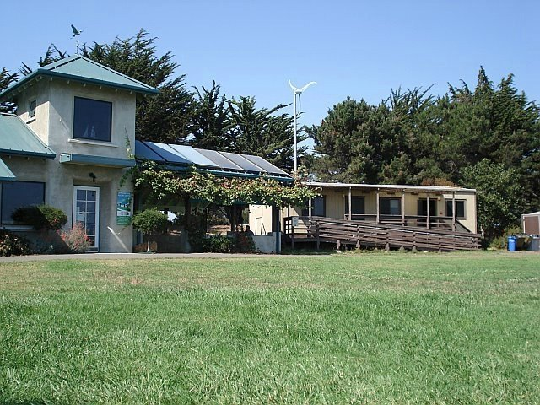
3.(ii)

Slide 21
Conclusion
Finally we can conclude that we are on peak of using our energy resources and this is very much clear from previous discussions that our non-renewable resources are on a peak of their use and one day ultimately they will vanish of their existence from world.
Main benefit of renewable energy is that it is clean form of energy and also socially acceptable and help government to make a dream true to provide electricity to the village.
So we need to develop our renewable energy resources more and more if we want to enjoy a peaceful and satisfactory life in today’s energy hungry world.

Slide 22
SOLUTIONS FOR SUSTAINABLE ENERGY
Improve energy efficiency
Increase local availability of renewable energy resources
Find transitional resources (natural gas, nuclear)
Government must promote R&D for alternative renewable energy resources.
Educate the public
All energy resources should compete in an open, free-market with NO government control!
Government needs to implement constructive subsidies not destructive subsidies to promote change, this will lead to conservation of resources and less over-consumption.

Slide 23
References
https://en.wikipedia.org/wiki/Renewable_energy.
https://www.eia.gov/energyexplained/?page=renewable_home

